Slide 1

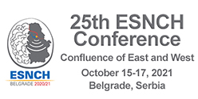


THROMBI ANALYSIS: FURTHER IN STROKE PATHOPHYSIOLOGY, HAEMODYNAMICS AND POSSIBLE THERAPEUTIC PERSPECTIVE
G. Liaci¹, F. Amati¹, A. Marzullo², F. Addabbo³,
C. Chiapparino⁴, L. Pascazio¹
¹Stroke Unit, Department of Neuroscience, Policlinico Hospital, Bari, Italy
²Department of Pathology, Policlinico Hospital, Bari, Italy
³Department of Biomedical Science, Policlinico Hospital, Bari, Italy
⁴Department of Neurology, “F. Perinei” Hospital, Altamura (BA), Italy

Slide 2
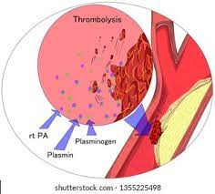
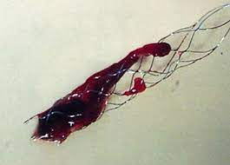
Background and aim
Recent studies reported the questionable utility of bridging therapy versus mechanical thrombectomy (MT) in acute ischaemic stroke (AIS) with large vessel occlusion (LVO).
This study focuses on the composition of extracted thrombi and the resulting haemodynamic repercussions on the cerebral circulation.

Slide 3
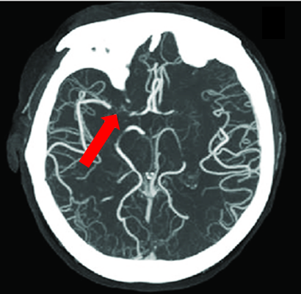
Methods
Thirty-seven LVO AIS patients (pts.), who were given either bridging therapy or MT, were studied.
Twenty-three pts. underwent combined treatment and fourteen isolated treatment (MT). Recanalization was achieved in all but two pts., with a good outcome in twenty-nine pts.
CTA showing right MCA occlusion (red arrow)

Slide 4
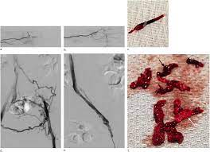
Results
The length of thrombi was difficult to assess as they rupture during the procedure; the morpho-histological analysis highlighted the presence of fibrin, red blood cells (RBC), platelets, leukocytes.

Slide 5
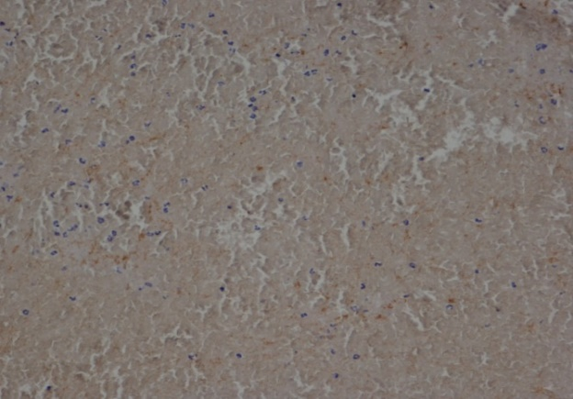
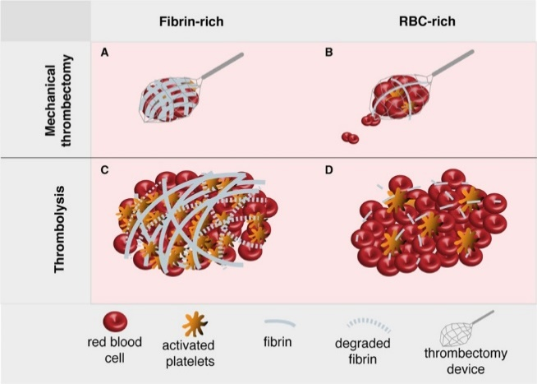
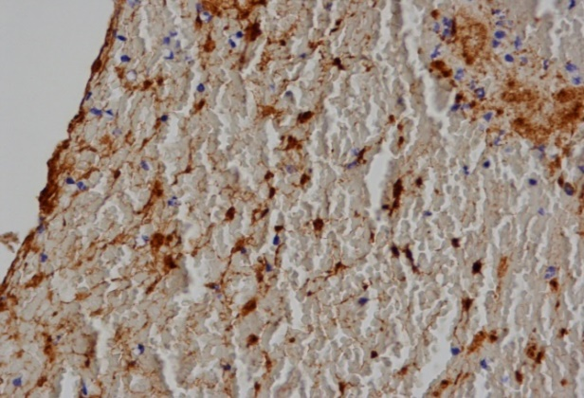
An almost similar amount of retrieved white and red thrombi (with a slight prevalence for red thrombi) was observed, with a nearly overlapping distribution in both procedures.
Histological image of a red clot.
White and red thrombi
vWF expression was higher in pts. treated with combined treatment, in line with fibrin load. The lower thrombus porosity seemed to promote collateral circulation.
Histological image of a red clot rich in factor VIII (brown areas).

Slide 6
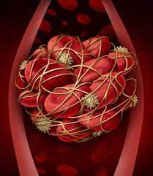
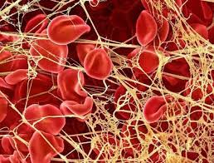
Statistics
Both procedures led to a favourable outcome: P<0.001;
no association between fibrin load, RBC load, hyperemia and type of treatment (either isolated or combined) was found: P>0.05 (MWT);
- an association trend between fibrin and atherosclerotic load:
P=0.1 was observed;
a correlation between collateralization and MT: P=0.037 (χ²T) was also detected;
almost total agreement between angiography and ultrasound was evident.

Slide 7
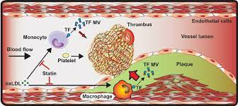
Conclusions
The study reveals the poor fibrinolytic efficacy of r-tPA against the thrombotic mechanism activation.
Without the proven superiority of MT, our investigation suggests that further research efforts should be made on thrombi composition and development, as neurosonology studies have shown, these latter to be linked to the progression of the atherosclerotic load and to the triggering of the inflammatory and thrombotic cascade.

Slide 8
CONCLUSIONS
Additional trials are useful in order to identify agents really capable of lysing thrombi, more effective thromboliytics, enzymes and novel ultrasounds.
Desmoteplase, Tenecteplase, Urokinase
(the latter in rabbit )
Therapeutic Ultrasound Properties on clot lysing

Slide 9
CONCLUSIONS
Many trials suggest sonothrombolysis is a technically feasible and potentially effective treatment that has beneficial effects on recanalization.
Ultrasound-Enhanced
Systemic Thrombolysis
Sonothrombolysis in Acute Stroke last trials:
Clotbust-ER, Trust, NOR-SASS 2
Mrusmi trial for Acute Stemi

